Slide 1
DevOps Strategy and Implementation Roadmap

Slide 2

Background & Objective
IFF- Current State Findings & Summary
DevOps Proposition and Recommendations
AGENDA
DevOps Governance Model
DevOps Roles and Responsibilities
Appendix

Slide 3
Background & Objective

Slide 4
DevOps Strategy and Implementation Roadmap- Background & Objective
Background
IFF initiated due diligence to provide recommendations on setting up an enterprise wide DevOps strategy and approach to modernize their IT platform to ensure quick provisioning of environments rapid releases of their applications which are defect free. The expectation was to develop an approach considering the current tool stack and automate wherever possible using Open source .
Objective
This DevOps engagement involves :
  Conducting an assessment of the current state Build, Deployment, Release, Environment and Monitoring processes and
  Arrive at a recommended state for the above processes
  Applications are analyzed for gaps across the following
    Requirements Traceability
    Infrastructure/Environment Management
    Source code/Build and Release Management
    Test management
    Monitoring and Feedback
The next set of slides depicts the assessment details, the current state findings and the approach to enable onboarding of applications to the recommended tool stack

Slide 5
DevOps Benefits for IFF
Development
Operations
Infrastructure
Business
Improved defect detection by 25% .
Decrease of manual time spend on deployments by 80%, provided the stages are auto approved,
Enables test driven development.
Enables change frequency to be increased from quarterly to daily.
Uptime of environments will be high as bug detection and testing is enables using CI/CD pipeline.
At least 20% reduction in pre- and post-deployment issues
Automation of rollback process will save operations team’s time.
Environment creation will be automated in a pipeline. It can be reduced to 2-3 hours from 2-3 weeks provided approval and catalogs are automated.
Infrastructure creation and maintenance will be seamless as it will be self service jobs run by Service Now.
Time from project ideation to materialization will decrease by 30% .
Applications will be stable.

Slide 6

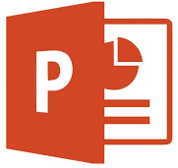
DevOps Due Diligence on Current Tools and Process
Completed
TBD
Finalize Assessment Plan
Meeting Stakeholders
Asses current state & tools
Discovery Sign-Off
Stakeholder Identification
Publish Activity Schedule
Publish recommendation approach
Deliverables
Assessment Plan
Current State Assessment
Interview Schedule and Questionnaire
Recommendations and Implementation Plan / Roadmap
Implementation phase will follow based on the current state findings and recommendations

Slide 7
IFF- Current State Findings & Summary

Slide 8
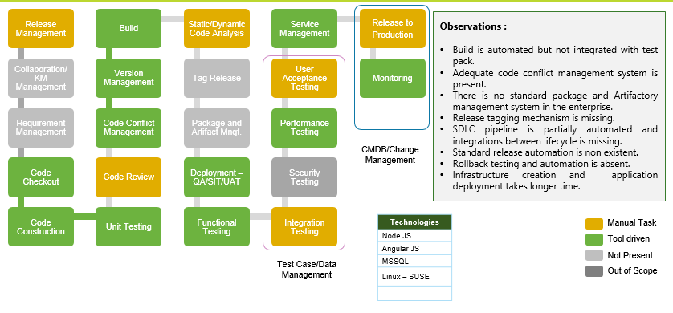
Current SDLC State – Custom Application Platform [CAP]
A current state summary and findings at the application level for custom application platform have been consolidated to make inferences. The findings with key observations, technology & tools used and process followed is represented below

Slide 9
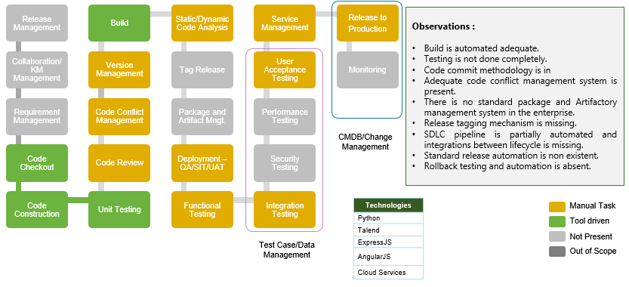
Current SDLC State – Data Analytics Platform [DAP]
A current state summary and findings at the application level for data analytics platform have been consolidated to make inferences. The findings with key observations, technology & tools used and process followed is represented below

Slide 10
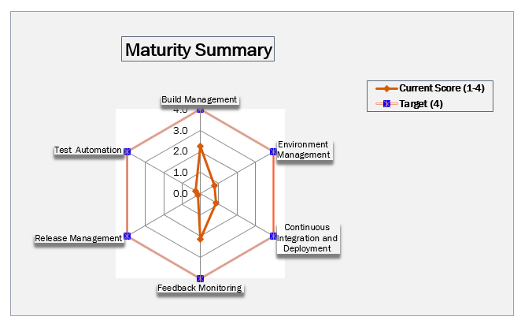
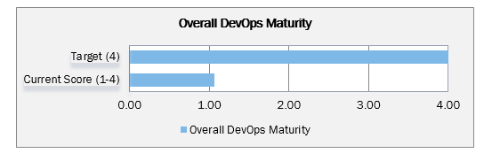
DevOps Maturity Scorecard Nascent -1.15/4 - 27%
Metrics Breakdown
Environment | Score
Cloud | 1.25
On-Premises | 1.05
Platform | Score
Custom Application Platform | 1.2
Rest Applications | 1.1

Slide 11
DevOps Strategy and High Level Plan

Slide 12
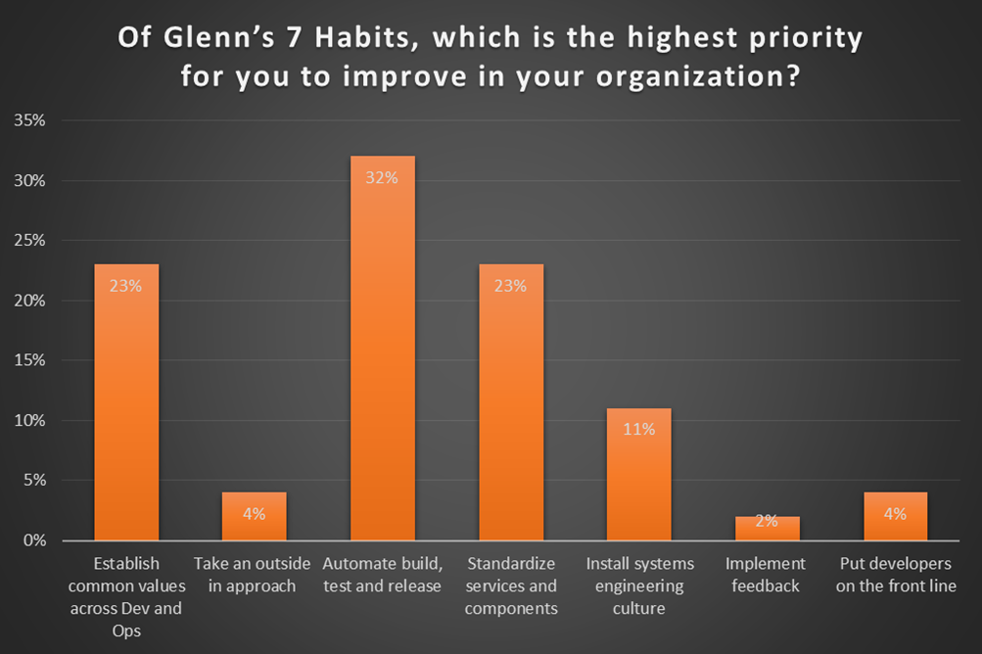
Seven Habits of Effective DevOps*
Establish common values & awareness between Dev and Ops
See everything through the eyes of the customer
Automate your build, testing and release management processes
Standardize the services and components used to build these services
Instill a culture of systems engineering across Dev and Ops
Adopt feedback and feed-forward in the service lifecycle
Put developers in the front line of service support
Four biggest themes of the poll results:
Collaborate
Standardize
Automate and
Systems engineering approach (metrics based)
* Glenn O’Donnell, Principal Analyst at Forrester
Source: Serena Webinar conducted by Glenn from Forrester

Slide 13
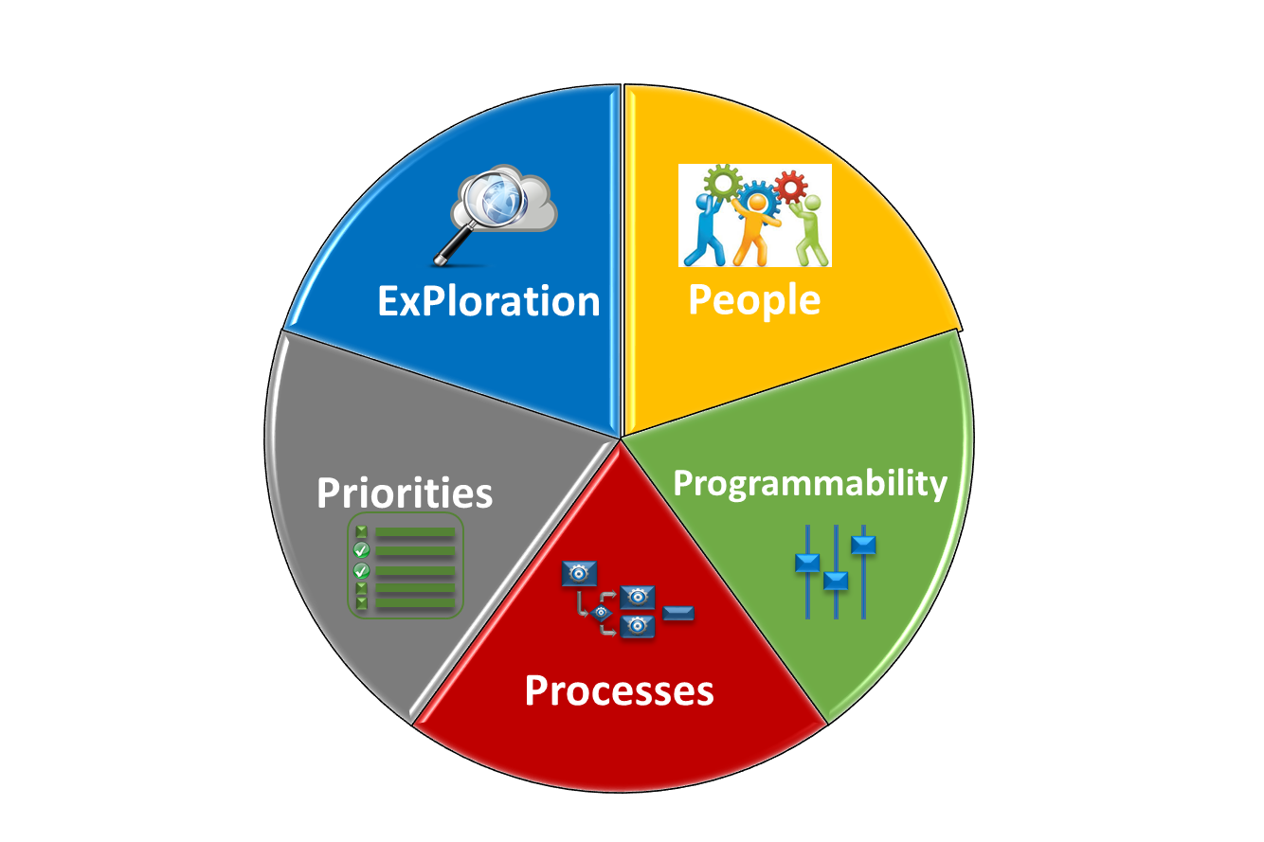



Role of DevOps
DevOps work at improving collaboration between development, testing and operations teams, optimizing the environments using a metrics based approach while constantly looking at the outside world and improving the technology ecosystem while reducing debt.
Enable People to collaborate and use
Programmability to automate and standardize
Processes and leverage measurement to meet business
Priorities. Constant Improvement by
exPloration of marketplace & introduction of new capabilities & services.
COLLABORATION
OPTIMIZATION
MEASUREMENT
EXPLORATION

Slide 14
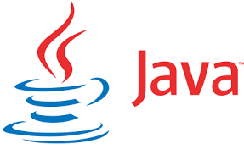


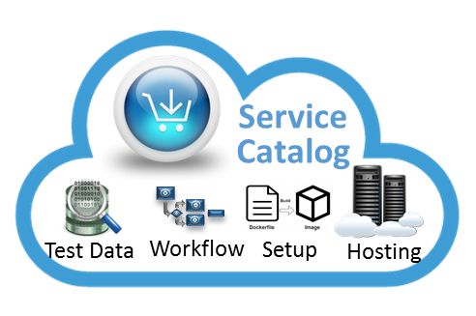


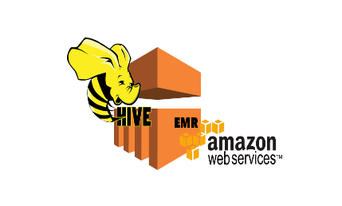
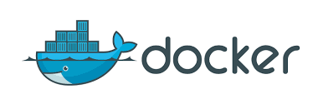

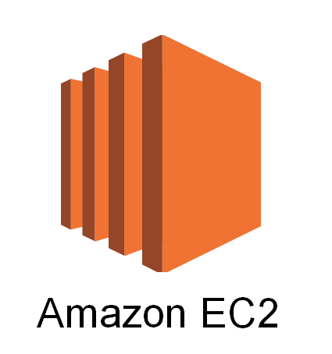
Focus of DevOps Team
The DevOps technology, processes and services are quite complex and constantly changing. So we need to focus on
  Capabilities (includes managing, optimizing and expanding current technical capabilities and processes)
  Pipeline (looking at new capabilities and external services)
  Services (combination of internal (coding, setup, test data, etc. ) and external services like (AWS, OpenShift, etc.))
Capabilities
Pipeline
Services

Slide 15


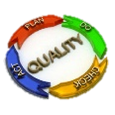


DevOps Framework
The team needs to work with its user base and stakeholders to determine how to provide/manage the capabilities and services.
  Determine and optimize value through feedback
  Determine Central or Federated model for each service or capability
  Work closely with other Business Units and Central Infrastructure and Operations teams for good practices and technology/process evolution
  Metrics based measurement and periodic reviews
  Provide roadmaps for capabilities and corresponding tools
  Manage training and talent
  Manage appropriate level of reliability, resilience and flexibility in the Eco-system.
Development Teams
Governance
Services could include:
Self service capabilities across AWS and other cloud capabilities
Setup new workflows based on business and dev team needs
Testing Services
Code samples and other DevOps configuration and coding
Test and Learn, Prototyping environment setup & mgmt.
Training and developer orientation in tooling
Business Strategy
Feedback
Feedback
Technology Evolution
Pipeline
Feedback
Capabilities
Feedback
Services
Enterprise Architecture Framework (App, Data, Infrastructure, Business)

Slide 16
DevOps Transformation Path
Current State
Gap
Future State
Build
Automation
Test Automation
Feedback
Monitoring
CI/CD
Infra as a Code
Complete DevOps
Partially present across all areas.
Complete build automation has to happen.
Partially present across all areas.
Sparsely present across all areas.
Streamlining test and dev to work hand in hand
Test driven development is recommended for complete test coverage
Currently, CI or CD process is not happening.
Complete build and test automation
Fully automated CI/CD pipeline.
All applications and servers will be provisioned automatically from catalog and availability is managed in service now.
Currently, done manually.
Environment management tools integration
Clearly implemented in current state.
Toolset and integration
Integrated with applications and self healing
Complete catalog driven app and infra deployment
N/A

Slide 17
Implementation Roadmap (Indicative)
Actionable recommendations and an implementation Roadmap to transition IFF from Current State to Target State with Quick wins or Short tem, Mid term and Long term strategic goals provided as below
Timeline | Short Term 0 – 3 months | Mid Term 3 – 6 months | Long Term 6 – 12 months
Devops | > Effective branching > Catalogue based server provisioning > CI/CD Tool & Environment provisioning and pipeline creation > Setting up of Release Management Process | > Catalogue based Application installation > Continuous deployment pipeline > Deployment Automation > Release automation tool implementation > Self healing system > Integration of Monitoring with CI/CD pipeline > Release automation | > Enable Continuous Testing > Enable Continuous Delivery > Automated roll-backs or blue/green deployment for reduced downtime window > Release Automation streamline and stabilization
Dev | > Build Automation for strategic apps > 100% Test automation > Setting of Server catalogue | > Merging across projects > Setting up of application catalogue | > Maintaining Continuous Quality
Infra | >Environment Management Initialization > Set up of Infra automation >Documenting standards and procedures | >Automated Environment Management provisioning and operations >Infrastructure baseline and smoke testing. | > Maintaining self-healing for more stable infrastructure
Ops | > Setting up of CMDB | > Need to setup Feedback mechanism to sync with CI/CD | > E2E process streamlining and E2E Release Co-Ordination

Slide 18
DevOps Proposition and Recommendations

Slide 19
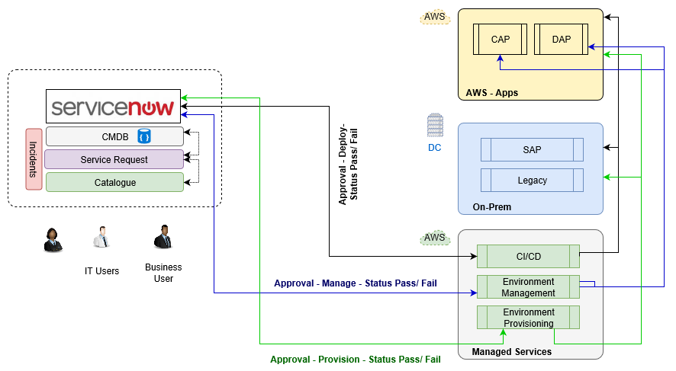
IFF Catalogue based DevOps Proposition
A need for consistent way to execute DevOps toolchain brings up the notion of Service catalogue. Service Catalog allows organizations to create, centrally manage and “execute” DevOps toolchains and one such using “Service now” is depicted below

Slide 20
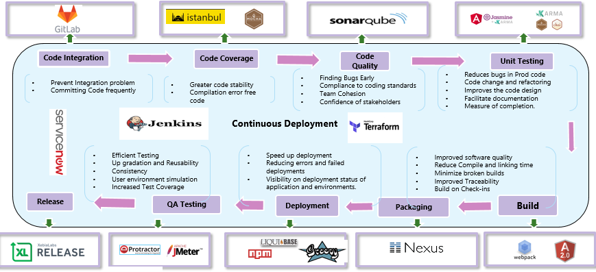
Proposed CI/CD Pipeline for Custom Application Platform
A unified DevOps model for a front end systems or a custom application platform in dealing changes in a consistent manner including Environment provisioning , Build/deployment/Test Automation, Artifact and Release Management is depicted below

Slide 21
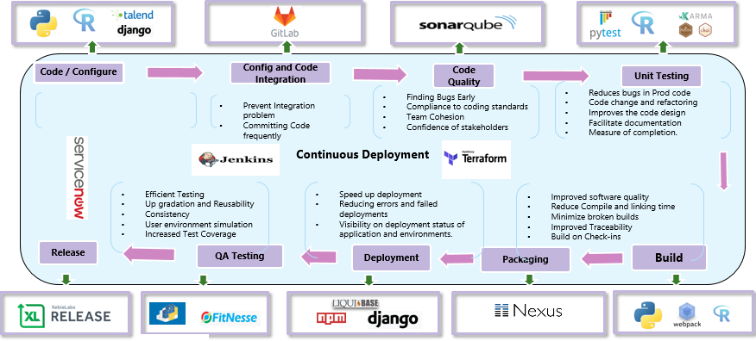
Proposed CI/CD Pipeline for Data Analytics Platform
A unified DevOps model for a data application platform in dealing changes in a consistent manner including Environment provisioning , Build/deployment/Test Automation, Artifact and Release Management is depicted below
Coding and configuration of dependent Software

Slide 22
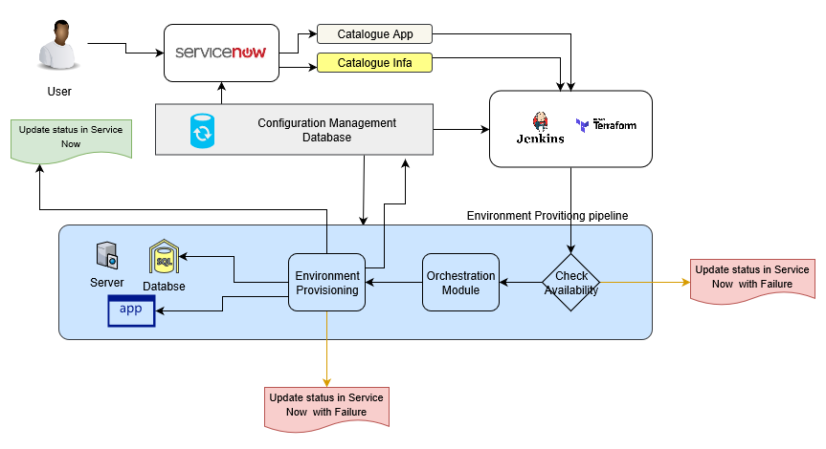
Automated Environment Provisioning model
An Automated provisioning, also called self-service provisioning -the process of scripting environments — from installing an operating system, to installing and configuring servers on instances, to configuring how the instances and software communicate with one another is depicted below
CMDB Driven environment, infrastructure and application provisioning
Service now will have the catalog base, created from CMDB; for each applications and infrastructure components.
CMDB is updated by Service now once the terraform play is successful with appropriate version as requested through catalog

Slide 23
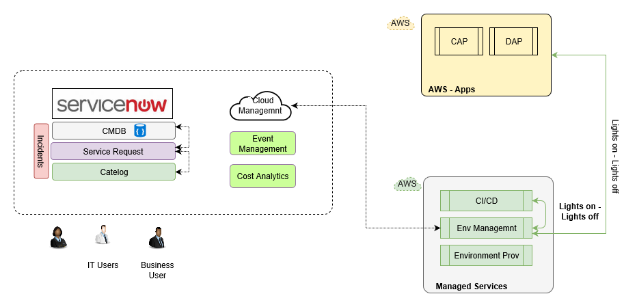
Automated Environment Management model
An automation framework for environment management in DevOps lifecycle includes management of environment usage including cost analytics and alerting.
Service Now based cloud management system.
Cost Analytics will manage the price based tagging for the project in Service Now, it works hand in hand with Event Management to check and shutdown the services and AWS instances.
Lights on should be always for environment provisioning model.

Slide 24
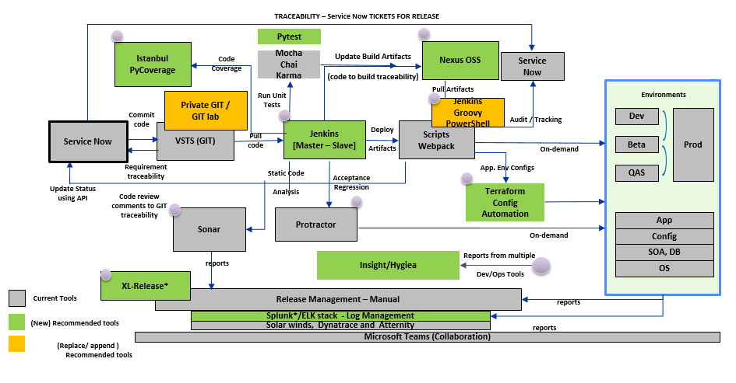
Overall DevOps Strategy Tools - Current vs Target State
DevOps is not ‘just a tooling’ solution – it is the harmony of Dev and Ops priorities enabled through “Agility” in lifecycle shown below
4
5
1
8
3
9
2
10
6
7
PS- Detail tool comparisons is available in the appendix
The numbers represents the Process flow from inception to finally delivery of a change

Slide 25
Standardize usage of tools for various functions
SDLC Phase | Function | Description | Recommended tools
Requirement Analysis and Planning | Requirement Management | Version control of requirement documents, Role based access to Document Libraries | Service Now
 | Change Assessment | Requirement Change Management | Service Now
 | Metrics Management & Reporting | Automated Impact Analysis and reporting through full life-cycle traceability, Real-time Business Readiness Dashboard | Hygiea/ Insights
Design Development & Source Control | Code Analysis | Automated Static Code Analysis, for correctness, security, and performance considerations | SonarQube
 | Source Control | Version control of Source Code | GITLab
 | Code Coverage | measure of Degree to which the source code of a program is executed when a particular test suite runs | Istanbull
 | Unit testing | Testing the smallest part of applications | Moka Chai
 | Test Automation | Test Automation Framework(s) to support Behavior Driven Development | Protractor
Continuous Integration | Continuous Build, Integration and Deployment | Continuous Integration & Automated Build Deployment Process, Installation Testing | Jenkins
Environment and Release management | Environment Provisioning | Automated Environment Provisioning, Automated Virtualised Service Deployment, Monitoring | Terraform
 | Deployment Management | Automated code deployment | Terraform
 | Monitoring | Monitoring of Applications and Infrastructure | Solarwinds, Dynatrace
 | Release Automation | Automating the process of packaging and deploying an application or update of an application from development, across various environments, and ultimately to production, including approvals | XL release
 | Artifactory Management | Release artifact maintenance and versioning for effective release management and rollback | Nexus OSS
 | Team collaboration | Collaboration and coordination between Development , Testing, and project Management team | Microsoft team

Slide 26
DevOps Governance Model
Roles and Responsibilities

Slide 27







DevOps Governance Model
DevOps COE
DevOps Architect
  Architecture plans
  Process selection and enhancements
  Tools selections
DevOps Engineer
  Tools implementation & Integrations
  Support
  Process implementation
Environment Engineer
  Tools implementation & Integrations for Environment Provisioning
  Operations and Support
Product Development
Common Functions
Features & region team
  Feature development requirements management,
  testing
Platform team
  Platform development, enhancements, upgrades, testing
Change control
  Change approvals
  Prioritization
Release managers
  Release management, co-ordination and approvals
Testing teams
  Functional, non-functional testing
  Automation focus
Systems & operations
  Environment build out, provisioning, management, monitoring setup etc
During Implementation
DevOps Architect
DevOps CI/CD engineer
DevOps Environment Automation Engineer
Post Implementation
DevOps Support Engineer [ Tools and Operations]
DevOps Environment Operations Engineer

Slide 28
Resourcing - Roles and Responsibilities (Indicative)
DevOps Architect
DevOps CI/CD/ Support engineer
Env. Automation / Support Engineer
Single point of contact for DevOps related issues and first point of escalation.
Tool setup and Provisioning
Tool Chain Integrations
Proactive suggestions on tooling and process
Setup, create, automate, manage and execute application builds, packaging and deployments
Create, update and maintain all necessary documentation (Install docs, Readme etc.,)
Drive Continuous Service & process improvements
Environment baselining and sync-up across non-production environments
Report status & metrics data periodically as required.
Source code management of applications
DevOps Tools Administration
Setup, create, automate, manage and execute application builds, packaging and deployments
Analyze, troubleshoot and resolve configuration, build, package and deployment failures
Collaborate, coordinate & communicate with various stakeholders as needed including 3rd party vendors
Identify opportunities for Continuous Service & process improvements
Create, update and maintain all necessary documentation (Install docs, Readme etc.,)
Adhere to and Change management process
Environment baselining and sync-up across non-production environments
Adherence to Environment delivery, Test environment strategy, Environment build & support, Release, Configuration and Capacity Management
Automate Test Environment provisioning and Delivery
Environment provisioning tools implementation and customization
Architect the EM tools and associated integration to deliver service management
End to end environment planning, environment provisioning, execution and governance at program level
Review progress of environments builds, Incidents, changes, scheduling and allocations issues.

Slide 29
Appendix

Slide 30
DevOps Toolsets Recommendations
SDLC Phase | Current tool | Compared with | Recommendations
Requirements tracking | Service Now | NA | Service now is highly customizable ITSM solution , has good integrations with many tools in the market and providing features like Incident , Change, problem , Asset and also Release Management . This tool can be used as –is
Software Configuration Management | VSTS | GitLab [ Recommended] | Comparing VSTS vs GitLab, GitLab is recommended. Some comparisons below GIT LAB Pros: GitLab is a free and open source project licensed under MIT. Comes with integrated CI/CD solution GitLab CI makes it dead simple to add continuous integration to any project. GitLab's Docker container makes setting up your GitLab server easy. GitLab provides a free way to host your own private repositories. GitLab's integration with JIRA makes it easier for teams to move quickly controlling ticket flow through commit messages. Cons: Navigation into projects can be difficult if you are part of a lot of groups. If you want to run GitLab yourself, you have to do all of the heavy lifting. VSTS Pros: Private repositories are free and unlimited for any user. Continuous integration available Integrated with Visual Studio IDE TFS and Git support Cons: Overwhelming complexity Closed-source Limited collaboration features

Slide 31
DevOps Toolsets Recommendations
SDLC Phase | Current tool | Recommended Tool | Compared with | Recommendations
Build/Compile | Jenkins standalone | Jenkins- Master Slave | Team city and Bamboo | Jenkins, TeamCity, and Bamboo are all excellent tools for continuous integration, automated builds, automated testing, and continuous delivery. and documentation, but again there are differences in depth and quality. Jenkins Jenkins is an open source project supported by developers around the world. Bamboo and TeamCity are both commercial tools developed and maintained by their parent businesses. Jenkins has a massive ecosystem of plugins, giving it unprecedented customization and extensibility. Team City TeamCity offers a rather usable free version that gives you 100 build configurations and unlimited builds. After that, pricing starts at $299 per year. It comes with enterprise support , stands the best in ease of set up and has good number of out of box integrations Bamboo Bamboo is the most expensive of the tools. It starts at just $10, but offers an extremely limited experience for this price. For the whole experience, you’ll have to license Bamboo for a one-time cost of $880 for 1 remote agent. It also comes with good support and fair number of integrations

Slide 32
DevOps Toolsets Recommendations
SDLC Phase | Current tool | Compared with | Recommendations
Artifact Management | None | Nexus, Artifactory Nexus OSS [ Recommended ] | Nexus: Pros: Has both OSS and Paid version(Pro) Nexus OSS provides free support for all major component formats like in Pro Nexus pro pricing based on number of users Cons: Doesn’t support parallel download of related artifact Artifactory: Pros: Has both OSS and Paid version(Pro) Supports parallel download of related artifacts Indexes any file in any format Supports subscription based pricing per year Cons: Artifactory OSS supports only Maven, Gradle and Ivy component format whereas Pro supports all major formats As artifactory management is still not been done in IFF to start with Nexus OSS is sufficient. There is always an opportunity to upgrade to Nexus Pro down the line. Nexus Pro comes with High availability and Professional support for 1 year
Code Quality | Sonarqube | None | SonarQube is an open source platform for continuous inspection of code quality to perform automatic reviews with static analysis of code to detect bugs, code smells, and security vulnerabilities on good number of programming languages. Offering reports on duplicated code, coding standards, unit tests, code coverage, code complexity, comments, bugs, and security vulnerabilities and available at no cost makes it an impressive choice in using it in integration with Jenkins
Unit testing/ Code coverage | Moka chai/ Istanbul | None | In the JS world, moka chai and Istanbul are good tools on unit testing and code coverage and can be used in existing capacity in integration with CI pipeline in Jenkins
Performance Test | Jmeter | None | JMeter is an Apache project that can be used as a load testing tool for analyzing and measuring the performance of a variety of services. Being open source it is sufficient to cater to the testing needs of IFF estate. For best results it can be integrated in Jenkins pipeline

Slide 33
DevOps Toolsets Recommendations
SDLC Phase | Current tool | Compared with | Recommendations
Log Monitoring and Feedback | None | Graylog, Splunk, ELK {Recommended} | Splunk and ELK are highly powerful, customizable and comprehensive log management and analysis. . While both of them are relatively easy to use and has good community support Splunk comes with high licensing cost. Both these offer good amount integrations and extensions but from the cost benefit analysis of these tools from the usage stand point in the current estate , we recommend ELK stack Splunk offers 500 MB of daily Indexing free of cost for 1 user in its free version but that does not come with high availability and alert support. It also falls short on DR , Access control and clustering aspects Graylog works pretty similar to ELK and has very good GUI. It also provides Rest API support and has nice access control and alert features; However it does have great reporting functionality like Splunk. If cost is not an option or business driver Graylog can also be considered Graylog offers free support of 10 incident per year and can be used for a limit of 5 GB/day.
Monitoring, Analytics | Dynatrace | None | Dynatrace Pros: It’s easy to install and fully automatic dash boarding is out of the box Single agent for everything from app monitoring to full stack monitoring Cons: Database monitoring is not powerful Support for dot net core is limited Custom reporting capability option is not there Dynatrace is the tool available in IFF already and offers similar features as that of AppDynamics or New Relic in the market. For most purposes in IFF estate , Dynatrace would suffice and can used.

Slide 34
DevOps Toolsets Recommendations
SDLC Phase | Current tool | Compared with | Recommendations
Deployment Automation | None | Ansible ,Terraform | Terraform is used as Orchestration tool and can be always used for maintain the desired state of the environment very effectively. It uses simple declarative language, working on Client only architecture and is capable of replacing both AWS cloud formation and Ansible put together. AWS cloud formation works only with AWS Infra. Both Ansible and Teraaform being Open source, we are recommending Terraform over Ansible for it scalability and ease of use
Release Automation | None | XL release | XL release is used to Plan, automate, and analyze the entire software release pipeline. It allows to identify risks early ensuring failure free software delivery. With Integrations support across multiple tools XL release can be a good choice of tool in Release automation space
Infra Automation | None | Ansible, Terraform | Same use case as that of Deployment Automation

Slide 35
Deployment Patterns
Type of Deployment | Description | Advantage | Disadvantage
Blue/Green Deployment | In the Blue/Green deployment pattern, a load balancer directs traffic to the active (Blue) environment while you upgrade the standby (Green) environment. After smoke testing the application in the Green environment and establishing that it is operating correctly, you adjust the load balancer to direct traffic from the Blue environment to the Green environment. | The Blue/Green deployment pattern provides a safe way to upgrade applications without interrupting their use. Blue/Green deployments work particularly well for monolithic applications that can take significant time to deploy, because you have full control over the point at which users can access the new version of the software. | Adopting the Blue/Green deployment pattern can increase operational overhead because you have to maintain duplicate Production environments with identical infrastructure. Additionally, updating database schemas while following a Blue/Green approach requires caution, as the new version of the application cannot use the database until it has been upgraded.
Rolling Updates | In a rolling update, each server node in the environment is taken offline and upgraded, one by one. After a node is upgraded, manual or automatic smoke testing determines whether the application is functioning as expected. If the application is up and running properly, its server node is made available for user traffic, and the next node is taken offline to be upgraded. | A rolling update is an incremental way of achieving zero-downtime deployments. Rolling updates work well for deployments that you expect to execute quickly, so you can minimize the impact on users. | While a rolling update is executing, the environment will be somewhat unpredictable because different versions of the application are running in it at the same time. Also, the application architecture must support running in cluster mode because multiple instances of the application will access the database during the update. Finally, taking servers offline means that there is less capacity for user traffic during the update.
Canary Releases | In a canary release, you upgrade an application on a subset of the infrastructure and allow a limited set of users to access the new version. This approach allows you to test the new software under a Production-like load, evaluate how well it meets users’ needs, and assess whether new features are profitable. A canary release is similar to a rolling update because it involves releasing a new feature in a staged manner. However, when you perform a rolling update, you only verify that the application is technically stable and functional before moving on to the next stage of the rollout. With a canary release, you evaluate users’ reactions to a new feature or functionality before deciding whether to release it more widely. | Canary releases are a good way to release experimental or beta features to users and gather their feedback. For example, you can use a canary release to roll out a new feature to users in a specific geographic region. If those users like the feature, you can deploy a canary to another region and test the user response there; or, you could choose to upgrade all remaining nodes in the environment, possibly by applying another release pattern to minimize application downtime. | Canary releases pose similar risks to rolling updates because multiple versions of the same application run in the environment while the canary release is deployed. For that reason, the environment will be somewhat unpredictable during the canary timeframe, and the application architecture must support running in cluster mode so that multiple instances can access the database

Slide 36
DevOps Transformation Timeline (Indicative)
Initiatives
M1 | M2 | M3 | M4 | M5 | M6 | M7 | M8 | M9 | M10 | M11 | M12
1 | CI/CD tool provisioning (GITLab, Jenkins, Nexus, XL Release, Istanbul Pycoverage, Pytest)
2 | Establish process and procedures around SCM, Build, Deployment and Release
3 | Establish Environment Automation
4 | Implement tool for Environment Automation (Terraform)
5 | Establish Tool chaining & integration for health-check and monitoring
6 | Implement Enterprise view of dashboard for proactive monitoring
7 | Implement Self serving portal – inbuilt self heal option
8 | Implement Release Automation
9 | Establish Governance Model, Roles & Responsibilities
10 | Implement ITSM processes and Continuous improvement
PS- Detail project plan is available in the appendix

Slide 37
Project Plan for DevOps Implementation (Tentative)

Slide 38
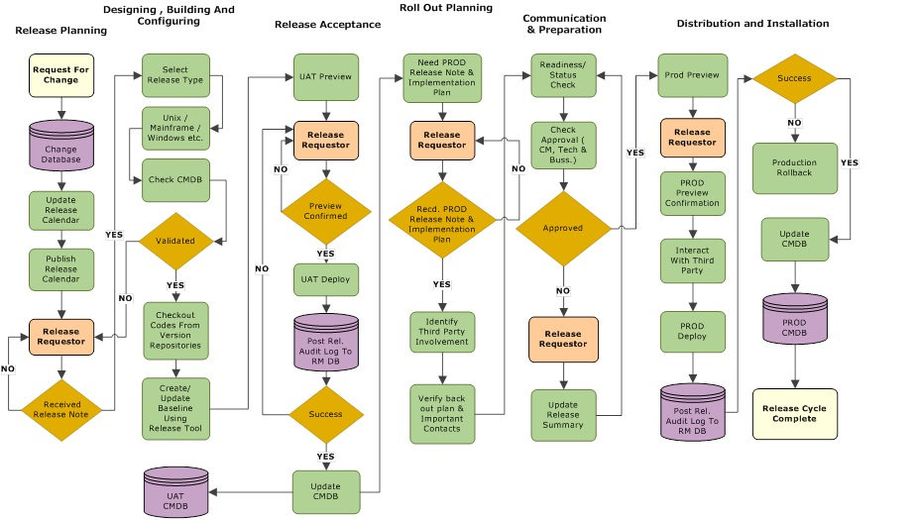
Typical Release Workflow
Release Management is the process of managing, planning, scheduling and controlling a software build through different stages and environments; including testing and deploying software releases.

